Slide 1

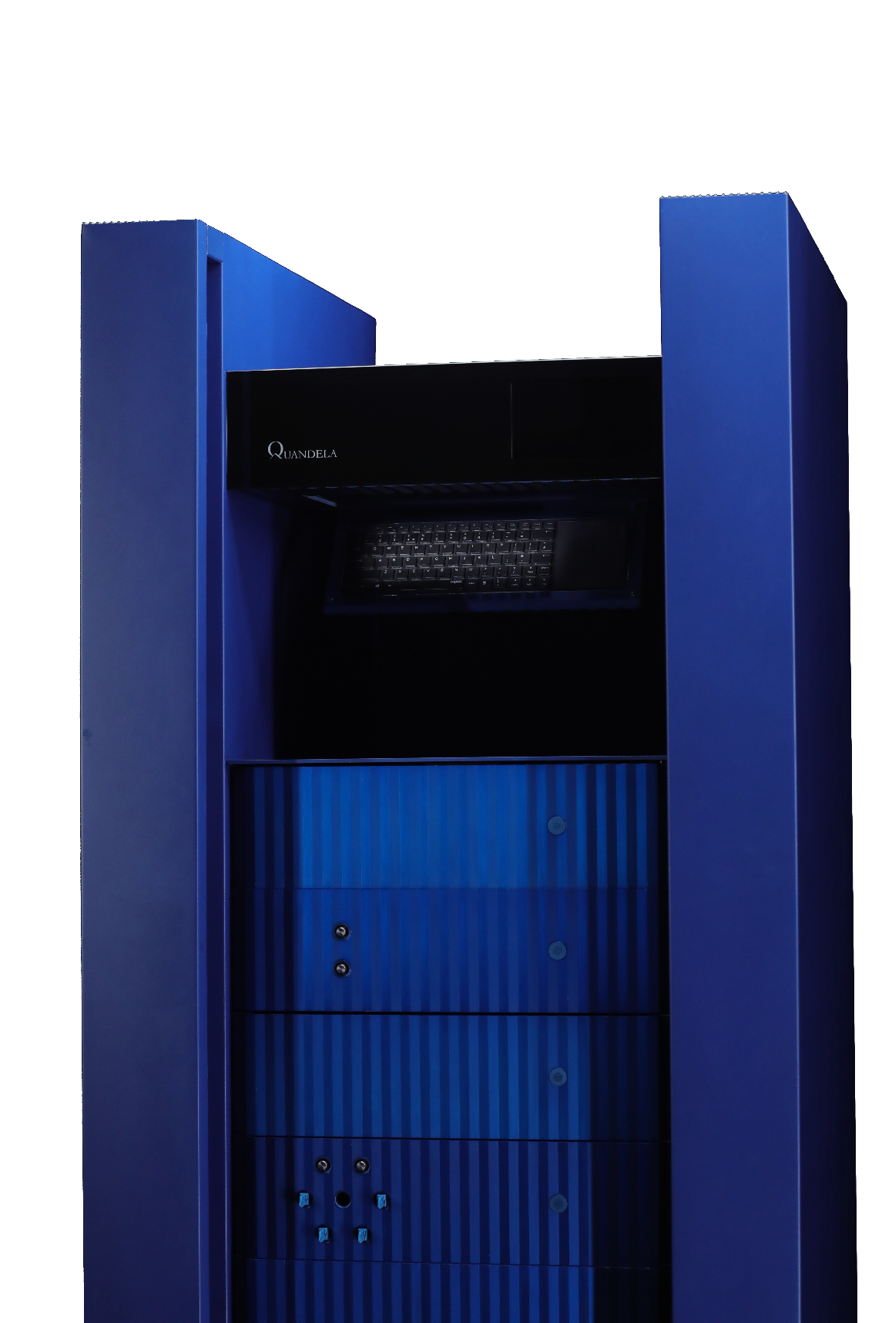


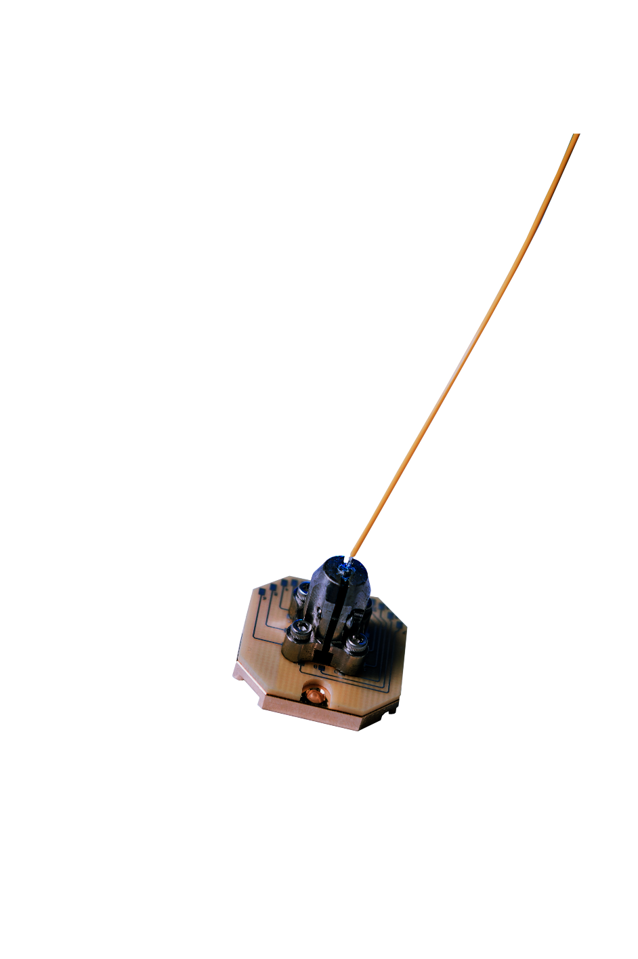


CONFIDENTIALITY NOTICE - The contents of this presentation is intended solely for the addressee and may contain confidential and/or privileged information and may be legally protected from disclosure. COPYRIGHT - Any reproduction of the images contained in this document without the authorization of the author is prohibited.
QML on Perceval – Gan et al.
By: Taha Hammadia
July 27, 2022

Slide 2
CONFIDENTIALITY NOTICE - The contents of this presentation is intended solely for the addressee and may contain confidential and/or privileged information and may be legally protected from disclosure. COPYRIGHT - Any reproduction of the images contained in this document without the authorization of the author is prohibited.
Introduction to QML
By: Taha Hammadia
July 27, 2022

Slide 3
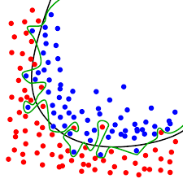
CONFIDENTIALITY NOTICE - The contents of this presentation is intended solely for the addressee and may contain confidential and/or privileged information and may be legally protected from disclosure. COPYRIGHT - Any reproduction of the images contained in this document without the authorization of the author is prohibited.
Machine Learning: Binary Classification
Train a machine to classify data (parameters and hyper-parameters)
Features determined manually (classical ML) VS Features determined automatically (deep ML)
Supervised: classified training set
Notes:
Define parameters and hyperparameters, features. Cats and dogs.
Define overfitting clearly

Slide 4

CONFIDENTIALITY NOTICE - The contents of this presentation is intended solely for the addressee and may contain confidential and/or privileged information and may be legally protected from disclosure. COPYRIGHT - Any reproduction of the images contained in this document without the authorization of the author is prohibited.
Machine Learning: Binary Classification
Train a machine to classify data (parameters and hyper-parameters)
Features determined manually (classical ML) VS Features determined automatically (deep ML)
Supervised: classified training set
Notes:
Define parameters and hyperparameters, features. Cats and dogs.
Define overfitting clearly

Slide 5

CONFIDENTIALITY NOTICE - The contents of this presentation is intended solely for the addressee and may contain confidential and/or privileged information and may be legally protected from disclosure. COPYRIGHT - Any reproduction of the images contained in this document without the authorization of the author is prohibited.
Machine Learning: Binary Classification
Train a machine to classify data (parameters and hyper-parameters)
Features determined manually (classical ML) VS Features determined automatically (deep ML)
Supervised: classified training set
Expressivity of a model: its ability to express complex functions $⇒$ complex limits between classes
Overfitting
Notes:
Define parameters and hyperparameters, features. Cats and dogs.
Define overfitting clearly

Slide 6
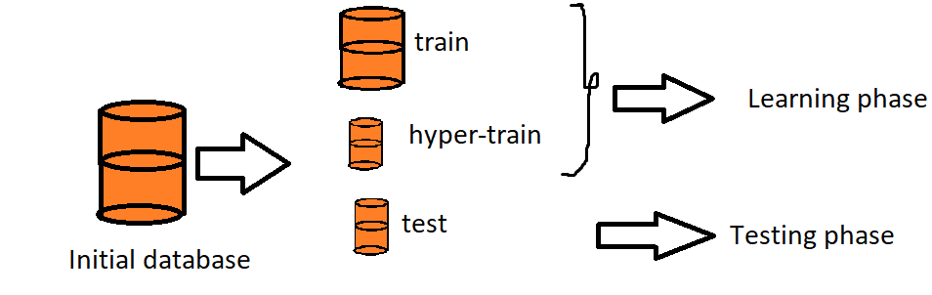
CONFIDENTIALITY NOTICE - The contents of this presentation is intended solely for the addressee and may contain confidential and/or privileged information and may be legally protected from disclosure. COPYRIGHT - Any reproduction of the images contained in this document without the authorization of the author is prohibited.
How is it done?

Slide 7
CONFIDENTIALITY NOTICE - The contents of this presentation is intended solely for the addressee and may contain confidential and/or privileged information and may be legally protected from disclosure. COPYRIGHT - Any reproduction of the images contained in this document without the authorization of the author is prohibited.
How is it done?
?

Slide 8
CONFIDENTIALITY NOTICE - The contents of this presentation is intended solely for the addressee and may contain confidential and/or privileged information and may be legally protected from disclosure. COPYRIGHT - Any reproduction of the images contained in this document without the authorization of the author is prohibited.
Testing phase
Score computation: portion of the test data set that was correctly labeled

Slide 9
CONFIDENTIALITY NOTICE - The contents of this presentation is intended solely for the addressee and may contain confidential and/or privileged information and may be legally protected from disclosure. COPYRIGHT - Any reproduction of the images contained in this document without the authorization of the author is prohibited.
Testing phase
Score computation: portion of the test data set that was correctly labeled
Base score: 0.5
Perfect score: 1

Slide 10
CONFIDENTIALITY NOTICE - The contents of this presentation is intended solely for the addressee and may contain confidential and/or privileged information and may be legally protected from disclosure. COPYRIGHT - Any reproduction of the images contained in this document without the authorization of the author is prohibited.
Quantum Machine Learning
Integration of quantum algorithms: 2 types
Quantum-enhanced ML: classical data - quantum computer
Improve computational speed / data storage
Execution of hard subroutines (kernels)
Work on quantum states instead of classical data (e.g. Grover algorithm)

Slide 11
CONFIDENTIALITY NOTICE - The contents of this presentation is intended solely for the addressee and may contain confidential and/or privileged information and may be legally protected from disclosure. COPYRIGHT - Any reproduction of the images contained in this document without the authorization of the author is prohibited.
QVA
By: Taha Hammadia
July 27, 2022

Slide 12
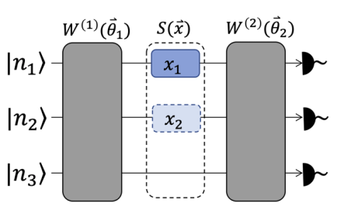
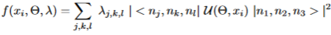


CONFIDENTIALITY NOTICE - The contents of this presentation is intended solely for the addressee and may contain confidential and/or privileged information and may be legally protected from disclosure. COPYRIGHT - Any reproduction of the images contained in this document without the authorization of the author is prohibited.
The method
1 PS per dimension
Non linearity: Fourier
coefficients ($ⅇ^{ⅈ{n′}_{j}x_{j}}$)
Quantum circuit:
Fine-tune the circuit parameters $\vec{θ_{i}}$ and the observable $λ$ for defining a good model:
Classification: take the sign of the model
Notes:
1 phase shifter per dimension
Non-linearity

Slide 13
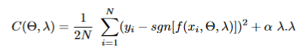
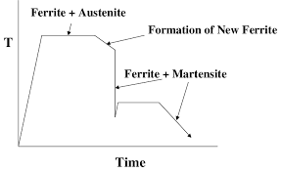
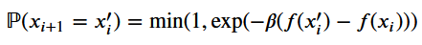

CONFIDENTIALITY NOTICE - The contents of this presentation is intended solely for the addressee and may contain confidential and/or privileged information and may be legally protected from disclosure. COPYRIGHT - Any reproduction of the images contained in this document without the authorization of the author is prohibited.
Training
Minimization of the loss function:
where $α$ is the regularization hyper-parameter → reduces over-fitting (intuition)
Minimization procedure: Dual annealing
Notes:
Change loss function

Slide 14
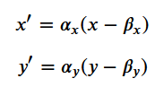
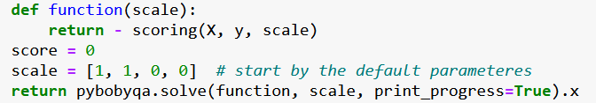
CONFIDENTIALITY NOTICE - The contents of this presentation is intended solely for the addressee and may contain confidential and/or privileged information and may be legally protected from disclosure. COPYRIGHT - Any reproduction of the images contained in this document without the authorization of the author is prohibited.
Hyper-training
Transformation
Local maximization of score

Slide 15
CONFIDENTIALITY NOTICE - The contents of this presentation is intended solely for the addressee and may contain confidential and/or privileged information and may be legally protected from disclosure. COPYRIGHT - Any reproduction of the images contained in this document without the authorization of the author is prohibited.
Key parameter
n: expressivity of the circuit

Slide 16
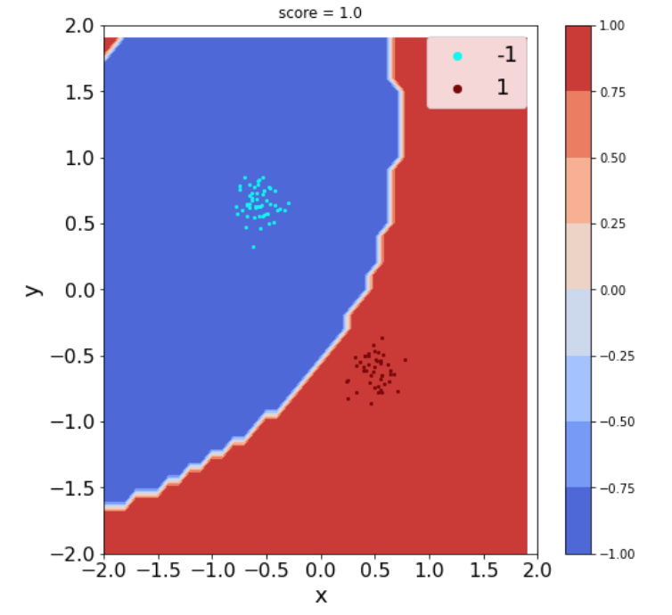
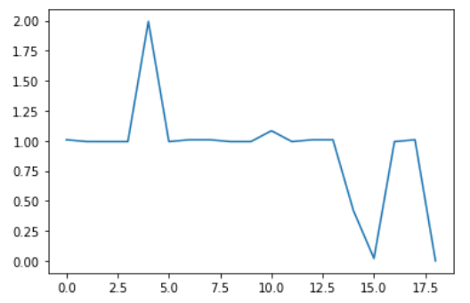
CONFIDENTIALITY NOTICE - The contents of this presentation is intended solely for the addressee and may contain confidential and/or privileged information and may be legally protected from disclosure. COPYRIGHT - Any reproduction of the images contained in this document without the authorization of the author is prohibited.
Results
Linear data set: n = 1
Loss function evolution

Slide 17
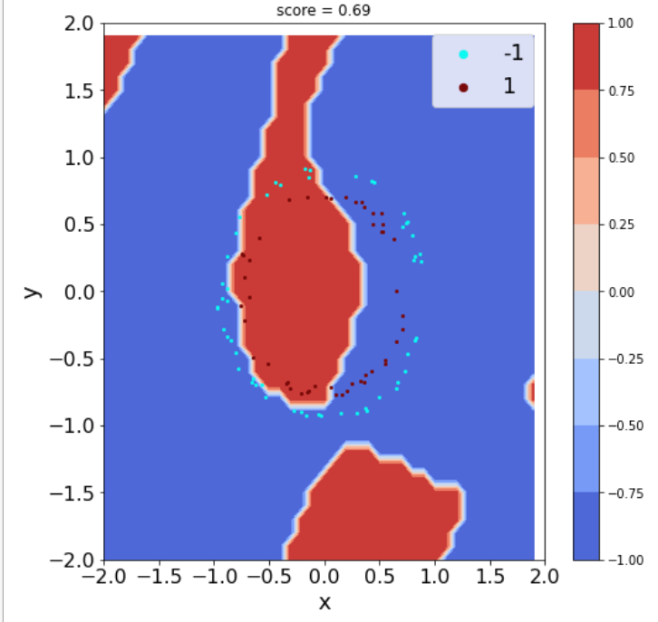
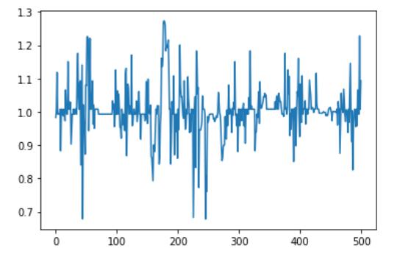
CONFIDENTIALITY NOTICE - The contents of this presentation is intended solely for the addressee and may contain confidential and/or privileged information and may be legally protected from disclosure. COPYRIGHT - Any reproduction of the images contained in this document without the authorization of the author is prohibited.
Results
Circular data set: n = 6
Loss function evolution

Slide 18
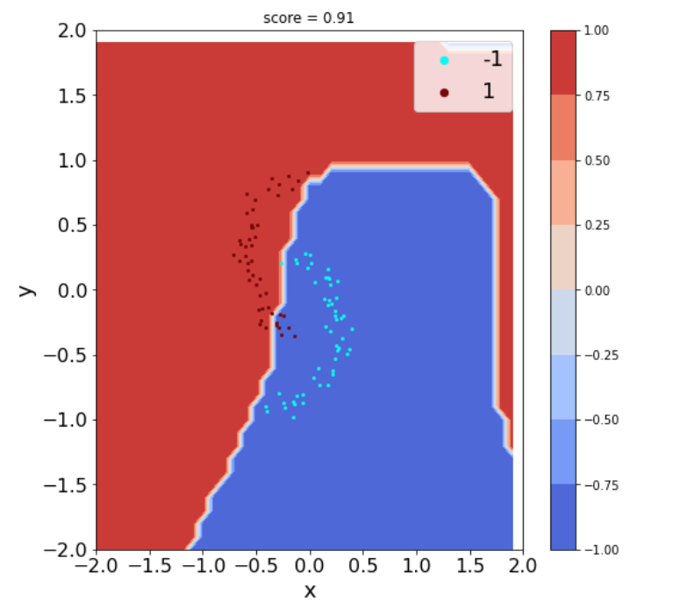
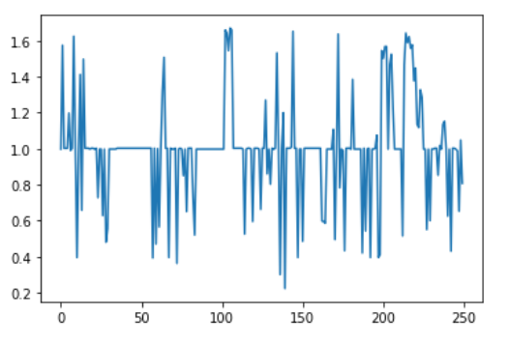
CONFIDENTIALITY NOTICE - The contents of this presentation is intended solely for the addressee and may contain confidential and/or privileged information and may be legally protected from disclosure. COPYRIGHT - Any reproduction of the images contained in this document without the authorization of the author is prohibited.
Results
Lunar data set: n = 3
Loss function evolution

Slide 19
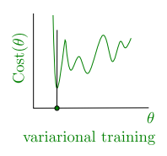
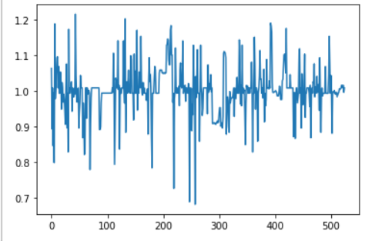
CONFIDENTIALITY NOTICE - The contents of this presentation is intended solely for the addressee and may contain confidential and/or privileged information and may be legally protected from disclosure. COPYRIGHT - Any reproduction of the images contained in this document without the authorization of the author is prohibited.
Method evaluation
N: train set size, M: number of trainable parameters, D: dimension of the feature space
Training complexity: O(N D M)
Prediction complexity [for 1 point]: O(D)
Natural, but hard training: the loss function is strongly non-convex:
loss function non-differentiable: taking off sgn does not improve
unnatural parameters

Slide 20
CONFIDENTIALITY NOTICE - The contents of this presentation is intended solely for the addressee and may contain confidential and/or privileged information and may be legally protected from disclosure. COPYRIGHT - Any reproduction of the images contained in this document without the authorization of the author is prohibited.
Quantum Kernel
By: Taha Hammadia
July 27, 2022

Slide 21
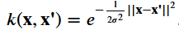
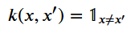
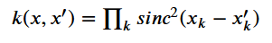
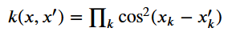
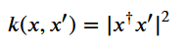
CONFIDENTIALITY NOTICE - The contents of this presentation is intended solely for the addressee and may contain confidential and/or privileged information and may be legally protected from disclosure. COPYRIGHT - Any reproduction of the images contained in this document without the authorization of the author is prohibited.
Kernels (1)
Kernel: bi-variate semi-definite positive function
Eg:
Shift-invariant kernel:

Slide 22
CONFIDENTIALITY NOTICE - The contents of this presentation is intended solely for the addressee and may contain confidential and/or privileged information and may be legally protected from disclosure. COPYRIGHT - Any reproduction of the images contained in this document without the authorization of the author is prohibited.
Kernels (2)
Theorem: there is a function φ, called the feature function such as:
k(x, y) = <φ(x), φ(y)>
Interpretation: proximity between the features of two data points in the feature space
Conversion: non-linear in the input space → linear in the feature space (high dimensional)

Slide 23
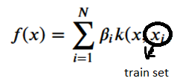
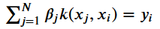
CONFIDENTIALITY NOTICE - The contents of this presentation is intended solely for the addressee and may contain confidential and/or privileged information and may be legally protected from disclosure. COPYRIGHT - Any reproduction of the images contained in this document without the authorization of the author is prohibited.
Linear system resolution
Representer theorem:
Linear system

Slide 24
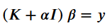
CONFIDENTIALITY NOTICE - The contents of this presentation is intended solely for the addressee and may contain confidential and/or privileged information and may be legally protected from disclosure. COPYRIGHT - Any reproduction of the images contained in this document without the authorization of the author is prohibited.
Linear system resolution
Representer theorem:
Linear system
Computation of the kernel matrix: (costly)
Model (β) expression:
where α is the regularization parameter – limits over-fitting + singular matrices

Slide 25

CONFIDENTIALITY NOTICE - The contents of this presentation is intended solely for the addressee and may contain confidential and/or privileged information and may be legally protected from disclosure. COPYRIGHT - Any reproduction of the images contained in this document without the authorization of the author is prohibited.
Circuit intuition
1 mode is not enough
Fourier transfrom: cos and sin $⇒$ 2 modes
Input: |n, 0>

Slide 26
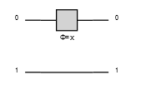

CONFIDENTIALITY NOTICE - The contents of this presentation is intended solely for the addressee and may contain confidential and/or privileged information and may be legally protected from disclosure. COPYRIGHT - Any reproduction of the images contained in this document without the authorization of the author is prohibited.
Circuit intuition
1 mode is not enough
Fourier transfrom: cos and sin $⇒$ 2 modes
Input: |n, 0>
Use 1 phase shifter: global phase ☹

Slide 27
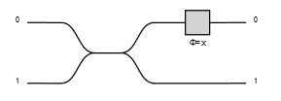
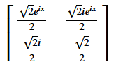

CONFIDENTIALITY NOTICE - The contents of this presentation is intended solely for the addressee and may contain confidential and/or privileged information and may be legally protected from disclosure. COPYRIGHT - Any reproduction of the images contained in this document without the authorization of the author is prohibited.
Circuit intuition
Fourier transfrom: cos and sin $⇒$ 2 modes
Input: |n, 0>
Use 1 phase shifter: global phase ☹
Solution: separate the photons into two groups
1 advanatge: Access different frequencies ☺
Unfortunately:

Slide 28
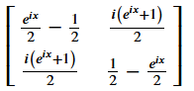
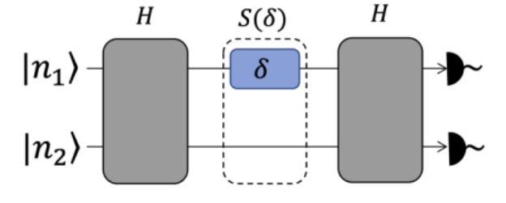
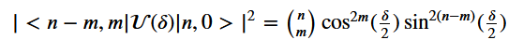
CONFIDENTIALITY NOTICE - The contents of this presentation is intended solely for the addressee and may contain confidential and/or privileged information and may be legally protected from disclosure. COPYRIGHT - Any reproduction of the images contained in this document without the authorization of the author is prohibited.
Quantum Gaussian Kernel
Quantum circuit:
BS
BS

Slide 29
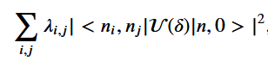
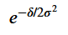
CONFIDENTIALITY NOTICE - The contents of this presentation is intended solely for the addressee and may contain confidential and/or privileged information and may be legally protected from disclosure. COPYRIGHT - Any reproduction of the images contained in this document without the authorization of the author is prohibited.
Quantum Gaussian Kernel
Quantum circuit:
Quantum observable:
Train the observable - model:
BS
BS

Slide 30
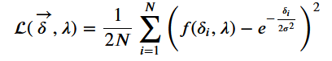
CONFIDENTIALITY NOTICE - The contents of this presentation is intended solely for the addressee and may contain confidential and/or privileged information and may be legally protected from disclosure. COPYRIGHT - Any reproduction of the images contained in this document without the authorization of the author is prohibited.
Learning the quantum kernel
Quadratic loss function:
High dimensional Fock space → λ large
Efficient minimization: scaling game (1e9 * λ with λ ~ 1e-3)
Training: U(0, 3) → Training on only (0, 3) [a^b]

Slide 31
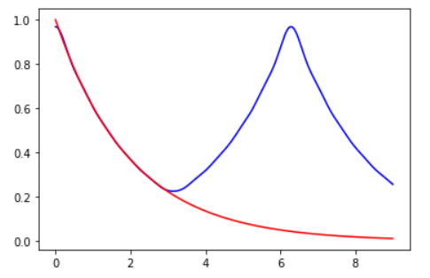
CONFIDENTIALITY NOTICE - The contents of this presentation is intended solely for the addressee and may contain confidential and/or privileged information and may be legally protected from disclosure. COPYRIGHT - Any reproduction of the images contained in this document without the authorization of the author is prohibited.
Use of a pre-computed λ
Value:
3

Slide 32
CONFIDENTIALITY NOTICE - The contents of this presentation is intended solely for the addressee and may contain confidential and/or privileged information and may be legally protected from disclosure. COPYRIGHT - Any reproduction of the images contained in this document without the authorization of the author is prohibited.
Key parameter
α: regularization of the classifier, limits the classifier’s expressivity

Slide 33
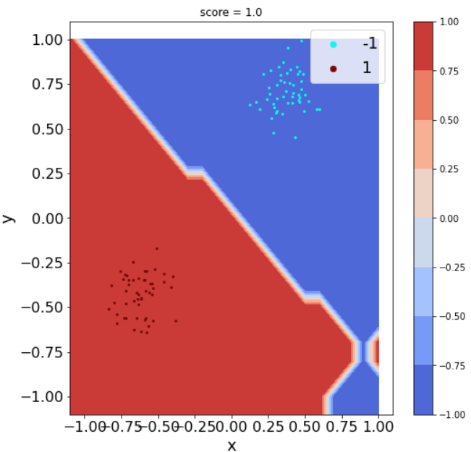
CONFIDENTIALITY NOTICE - The contents of this presentation is intended solely for the addressee and may contain confidential and/or privileged information and may be legally protected from disclosure. COPYRIGHT - Any reproduction of the images contained in this document without the authorization of the author is prohibited.
Results
Linear data set: α = 2

Slide 34
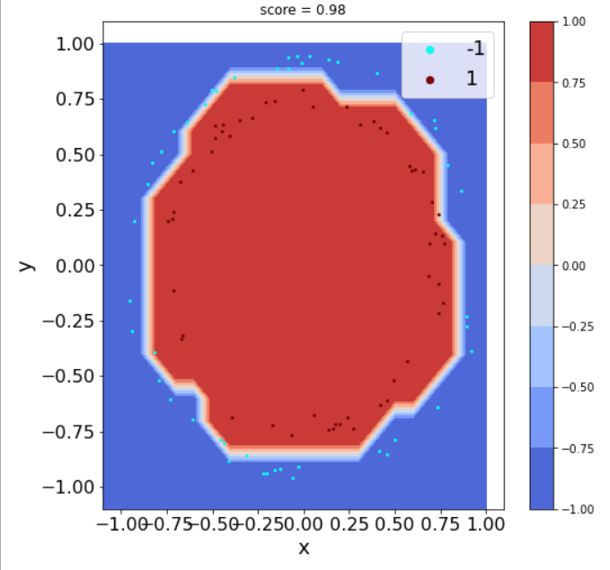
CONFIDENTIALITY NOTICE - The contents of this presentation is intended solely for the addressee and may contain confidential and/or privileged information and may be legally protected from disclosure. COPYRIGHT - Any reproduction of the images contained in this document without the authorization of the author is prohibited.
Results
Circular data set: α = 1.5

Slide 35
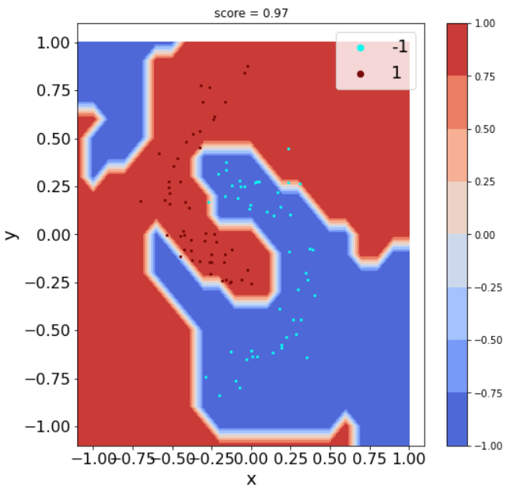
CONFIDENTIALITY NOTICE - The contents of this presentation is intended solely for the addressee and may contain confidential and/or privileged information and may be legally protected from disclosure. COPYRIGHT - Any reproduction of the images contained in this document without the authorization of the author is prohibited.
Results
Lunar data set: α = 0.3

Slide 36
CONFIDENTIALITY NOTICE - The contents of this presentation is intended solely for the addressee and may contain confidential and/or privileged information and may be legally protected from disclosure. COPYRIGHT - Any reproduction of the images contained in this document without the authorization of the author is prohibited.
Method evaluation
Accessible kernels for unknown features
Training complexity: O(N^2)
Prediction complexity [for 1 point]: O(N)
High dependency on α!!

Slide 37
CONFIDENTIALITY NOTICE - The contents of this presentation is intended solely for the addressee and may contain confidential and/or privileged information and may be legally protected from disclosure. COPYRIGHT - Any reproduction of the images contained in this document without the authorization of the author is prohibited.
Quantum-enhanced RKS
By: Taha Hammadia
July 27, 2022

Slide 38

CONFIDENTIALITY NOTICE - The contents of this presentation is intended solely for the addressee and may contain confidential and/or privileged information and may be legally protected from disclosure. COPYRIGHT - Any reproduction of the images contained in this document without the authorization of the author is prohibited.
Motivation
Kernel methods rely on matrix manipulation $⇒$ limitation on the size of the data set
Solution for shift invariant kernels: sample a random subset of the Fourier components.
Representative Kernel Hilbert Space ≈ low dimension subspace

Slide 39
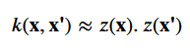
CONFIDENTIALITY NOTICE - The contents of this presentation is intended solely for the addressee and may contain confidential and/or privileged information and may be legally protected from disclosure. COPYRIGHT - Any reproduction of the images contained in this document without the authorization of the author is prohibited.
Explanation of the method (1)
Goal: inner product in the low-dimension subspace ≈ inner product in the feature space

Slide 40
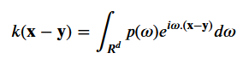
CONFIDENTIALITY NOTICE - The contents of this presentation is intended solely for the addressee and may contain confidential and/or privileged information and may be legally protected from disclosure. COPYRIGHT - Any reproduction of the images contained in this document without the authorization of the author is prohibited.
Explanation of the method (1)
Goal: inner product in the low-dimension subspace ≈ inner product in the feature space
Bochner’s theorem: a well-scaled continuous positive definite shift invariant kernel is the Fourier transform of a probability density

Slide 41
CONFIDENTIALITY NOTICE - The contents of this presentation is intended solely for the addressee and may contain confidential and/or privileged information and may be legally protected from disclosure. COPYRIGHT - Any reproduction of the images contained in this document without the authorization of the author is prohibited.
Explanation of the method (1)
Goal: inner product in the low-dimension subspace ≈ inner product in the feature space
Bochner’s theorem: a well-scaled continuous positive definite shift invariant kernel is the Fourier transform of a probability density
k and p are real:
Unbiased estimate of k
Notes:
Crochets

Slide 42
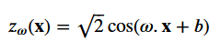
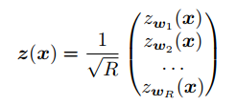
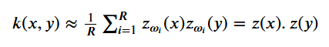
CONFIDENTIALITY NOTICE - The contents of this presentation is intended solely for the addressee and may contain confidential and/or privileged information and may be legally protected from disclosure. COPYRIGHT - Any reproduction of the images contained in this document without the authorization of the author is prohibited.
Explanation of the method (2)
Set:
Law of large numbers
Using Hoeffding’s inequality: z(x).z(y) converges unif. loc. to k(x, y).

Slide 43
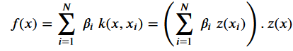
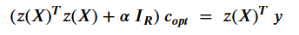
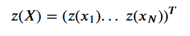
CONFIDENTIALITY NOTICE - The contents of this presentation is intended solely for the addressee and may contain confidential and/or privileged information and may be legally protected from disclosure. COPYRIGHT - Any reproduction of the images contained in this document without the authorization of the author is prohibited.
Explanation of the method (3)
Idea: use probability distributions for kernel definition
Expressing unknown kernels through their Fourier transform
Model expression:
Linear system resolution:
where:

Slide 44
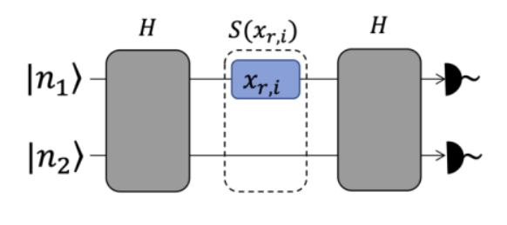
CONFIDENTIALITY NOTICE - The contents of this presentation is intended solely for the addressee and may contain confidential and/or privileged information and may be legally protected from disclosure. COPYRIGHT - Any reproduction of the images contained in this document without the authorization of the author is prohibited.
Quantum implementation
Quantum circuit:
Input state |10, 0>

Slide 45
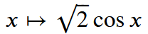

CONFIDENTIALITY NOTICE - The contents of this presentation is intended solely for the addressee and may contain confidential and/or privileged information and may be legally protected from disclosure. COPYRIGHT - Any reproduction of the images contained in this document without the authorization of the author is prohibited.
Learning
Loss function:
High dimensional Fock space → λ large
Efficient minimization: scaling game (1e6 * λ with λ ~ 1)
Training: U(0, 2 π) → periodicity

Slide 46

CONFIDENTIALITY NOTICE - The contents of this presentation is intended solely for the addressee and may contain confidential and/or privileged information and may be legally protected from disclosure. COPYRIGHT - Any reproduction of the images contained in this document without the authorization of the author is prohibited.
Use of pre-computed λ
Value

Slide 47

CONFIDENTIALITY NOTICE - The contents of this presentation is intended solely for the addressee and may contain confidential and/or privileged information and may be legally protected from disclosure. COPYRIGHT - Any reproduction of the images contained in this document without the authorization of the author is prohibited.
Kernel generation (1)
Gaussian kernel, law: normal
R = 10
R = 100

Slide 48

CONFIDENTIALITY NOTICE - The contents of this presentation is intended solely for the addressee and may contain confidential and/or privileged information and may be legally protected from disclosure. COPYRIGHT - Any reproduction of the images contained in this document without the authorization of the author is prohibited.
Kernel generation (2)
Laplace kernel, law Cauchy
R = 10
R = 100

Slide 49

CONFIDENTIALITY NOTICE - The contents of this presentation is intended solely for the addressee and may contain confidential and/or privileged information and may be legally protected from disclosure. COPYRIGHT - Any reproduction of the images contained in this document without the authorization of the author is prohibited.
Kernel generation (3)
Cauchy kernel, law Laplace
R = 10
R = 100

Slide 50

CONFIDENTIALITY NOTICE - The contents of this presentation is intended solely for the addressee and may contain confidential and/or privileged information and may be legally protected from disclosure. COPYRIGHT - Any reproduction of the images contained in this document without the authorization of the author is prohibited.
Kernel generation (4)
Squared sinc kernel, law triangular
R = 10
R = 100

Slide 51
CONFIDENTIALITY NOTICE - The contents of this presentation is intended solely for the addressee and may contain confidential and/or privileged information and may be legally protected from disclosure. COPYRIGHT - Any reproduction of the images contained in this document without the authorization of the author is prohibited.
Key parameters
γ: scaling parameter
R: accuracy of the approximated expectation, higher values of R means higher expressivity

Slide 52

CONFIDENTIALITY NOTICE - The contents of this presentation is intended solely for the addressee and may contain confidential and/or privileged information and may be legally protected from disclosure. COPYRIGHT - Any reproduction of the images contained in this document without the authorization of the author is prohibited.
Results (1)
γ = 0.1
Linear data set: R = 3

Slide 53

CONFIDENTIALITY NOTICE - The contents of this presentation is intended solely for the addressee and may contain confidential and/or privileged information and may be legally protected from disclosure. COPYRIGHT - Any reproduction of the images contained in this document without the authorization of the author is prohibited.
Results (2)
γ = 0.1
Circular data set: R = 10

Slide 54

CONFIDENTIALITY NOTICE - The contents of this presentation is intended solely for the addressee and may contain confidential and/or privileged information and may be legally protected from disclosure. COPYRIGHT - Any reproduction of the images contained in this document without the authorization of the author is prohibited.
Results (3)
γ = 0.1
Lunar data set: R = 20

Slide 55


CONFIDENTIALITY NOTICE - The contents of this presentation is intended solely for the addressee and may contain confidential and/or privileged information and may be legally protected from disclosure. COPYRIGHT - Any reproduction of the images contained in this document without the authorization of the author is prohibited.
Results (4)
γ = 10
Ad hoc data set:
R = 75
Random Forest
RKS

Slide 56
CONFIDENTIALITY NOTICE - The contents of this presentation is intended solely for the addressee and may contain confidential and/or privileged information and may be legally protected from disclosure. COPYRIGHT - Any reproduction of the images contained in this document without the authorization of the author is prohibited.
Method evaluation
The fastest and most accurate method so far
Fourier features of unknown kernels
Training complexity: O(N R)
Prediction complexity [for 1 point]: O(R)
If γ is well-chosen, the kernel does not matter. Otherwise, it does.

Slide 57
CONFIDENTIALITY NOTICE - The contents of this presentation is intended solely for the addressee and may contain confidential and/or privileged information and may be legally protected from disclosure. COPYRIGHT - Any reproduction of the images contained in this document without the authorization of the author is prohibited.
Coming Next
Multi-class classification OK
Noise modelization …
Experimental implementation …
Sampling instead of prob dist?
Post-selection? Feedforward?

